Slide 1
Arduino Methods
Brandon Wood,
Weston Summer 2017

Slide 2
Overview
Functions, or methods
Arduino’s main methods
Hello, world!

Slide 3
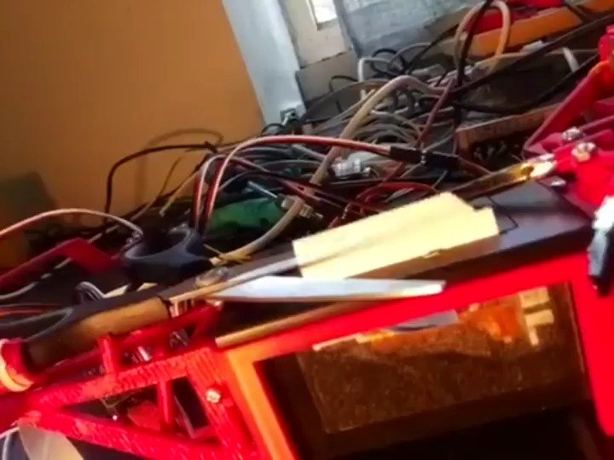

Slide 4
What Is a function?
Some stuff
Number
Another
Number
String
String
Array
Array

Slide 5
An example
“What’s the time?”
“Noonish”
Chatty
12
[12,30]

Slide 6
Defining functions
type name(inputs){
code code code
return type;
}

Slide 7
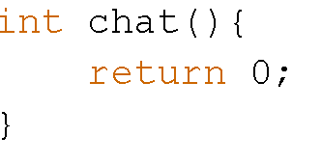
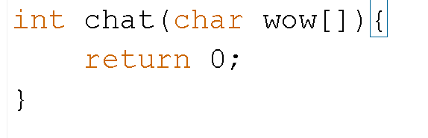
Arduino

Slide 8
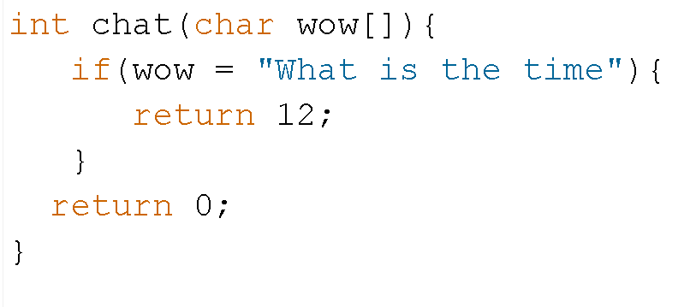

Slide 9
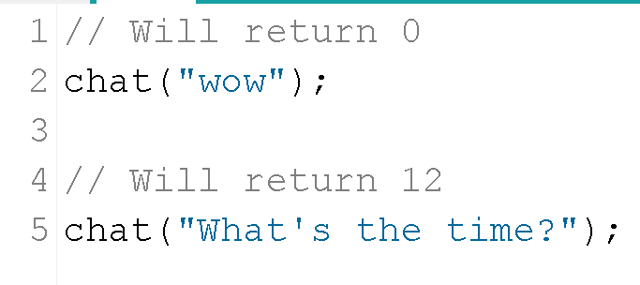
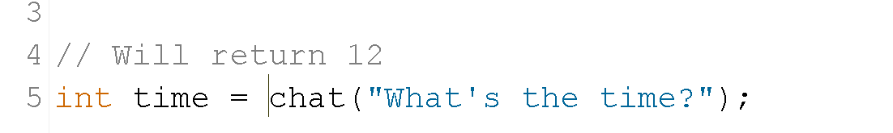
Calling or using functions
Name(parameters);
Type wow = chat(parameters);

Slide 10
Notation
Functions
Arguments
Methods
Functions
Inputs
Parameters
Arguments
Inputs

Slide 11
